Slide 1
Transport Layer

Slide 2
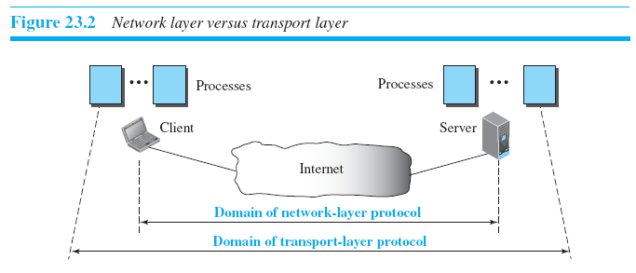
Transport Layer Services
Process-to-Process Communication

Slide 3
Transport Layer Services
Addressing: Port Numbers
To define the processes, we need second identifiers, called port numbers.
Port Address – 16 bit
The client program defines itself with a port number, called the ephemeral port number – short lived
TCP/IP has decided to use universal port numbers for servers; called well-known port numbers.

Slide 4
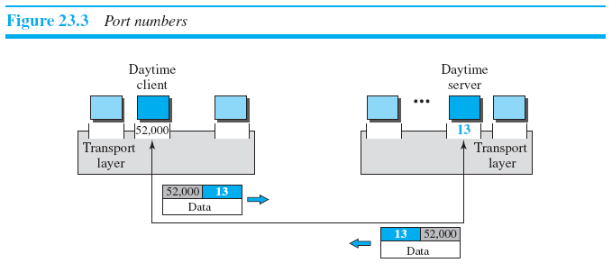
Transport Layer Services

Slide 5
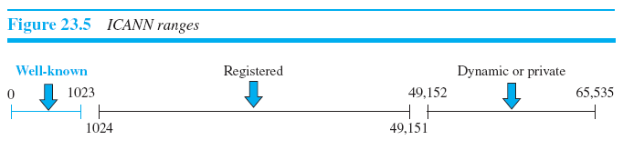
Transport Layer Services
ICANN (Internet Corporation for Assigned Names and Numbers) Range
Not controlled by ICANN only registered here
Neither controlled nor registered by ICANN
Assigned and controlled by ICANN

Slide 6
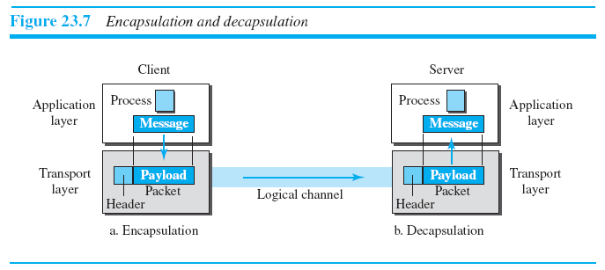
Transport Layer Services
Encapsulation and Decapsulation

Slide 7
Transport Layer Services
Multiplexing and Demultiplexing
The transport layer at the source performs multiplexing; the transport layer at the destination performs demultiplexing

Slide 8
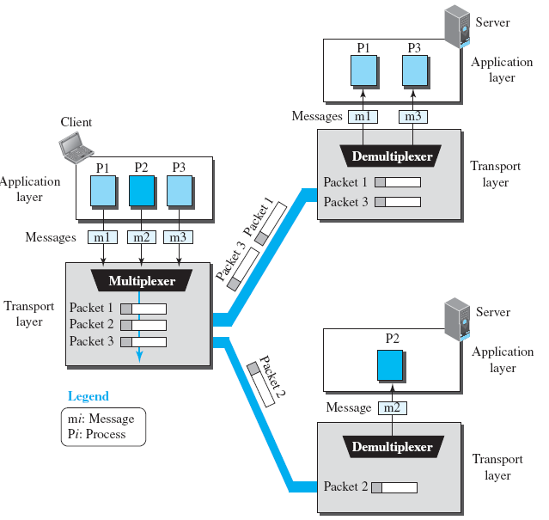

Slide 9
Transport Layer Services
Flow Control
balance between production and consumption rates.
Pushing or Pulling
Pushing - If the sender delivers items whenever they are produced ⎯ without a prior request from the consumer
Pulling - If the producer delivers the items after the consumer has requested them

Slide 10
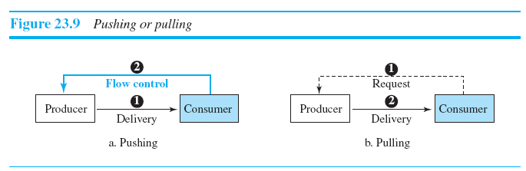

Slide 11
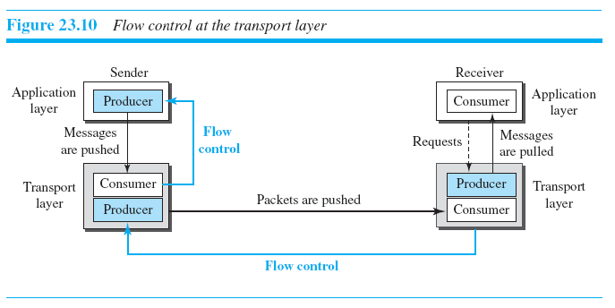
Transport Layer Services
Flow Control at Transport Layer

Slide 12
Transport Layer Services
Buffers
use two buffers: one at the sending transport layer and the other at the receiving transport layer.
When the buffer of the sending transport layer is full, it informs the application layer to stop passing chunks of messages.
When the buffer of the receiving transport layer is full, it informs the sending transport layer to stop sending packets.

Slide 13
Transport Layer Services
Error Control
Error control at the transport layer is responsible for
1. Detecting and discarding corrupted packets.
2. Keeping track of lost and discarded packets and resending them.
3. Recognizing duplicate packets and discarding them.
4. Buffering out-of-order packets until the missing packets arrive.

Slide 14
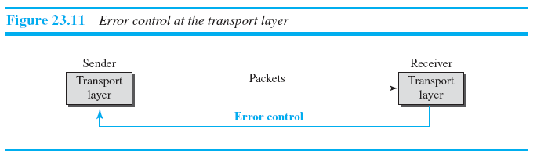
Transport Layer Services
Receiving transport layer manages error control, most of the time, by informing the sending transport layer about the problems.

Slide 15
Transport Layer Services
Sequence Numbers
For error control, the sequence numbers are modulo 2m, where m is the size of the sequence number field in bits.
Acknowledgment
both positive and negative ack signals as error control

Slide 16
Transport Layer Services
Congestion Control
Congestion control refers to the mechanisms and techniques that control the congestion and keep the load below the capacity.
Congestion at the transport layer is actually the result of congestion at the network layer, which manifests itself at the transport layer.

Slide 17
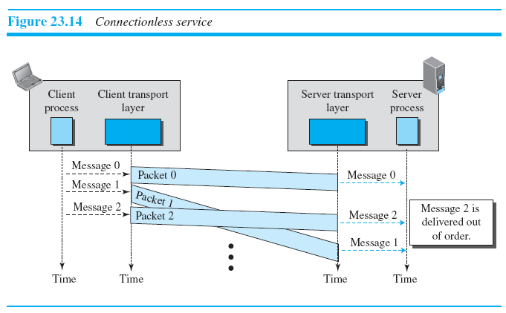
Connectionless service

Slide 18
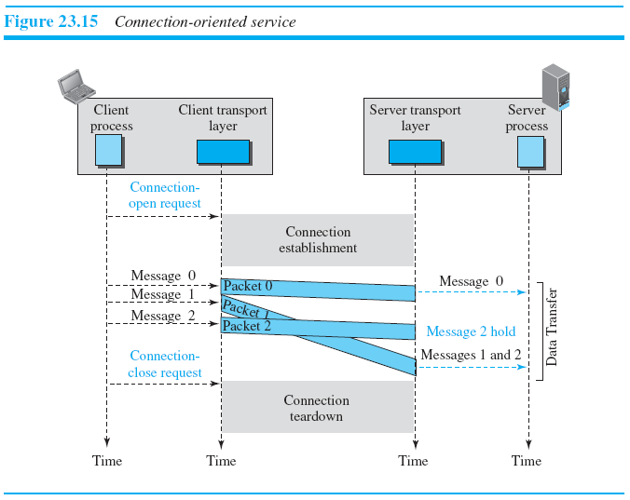
Connection-Oriented Service

Slide 19
Finite State Machine
Behavior of a transport-layer protocol, both when it provides a connectionless and when it provides a connection-oriented protocol, can be better shown as a finite state machine (FSM).
each transport layer (sender or receiver) is taught as a machine with a finite number of states.

Slide 20
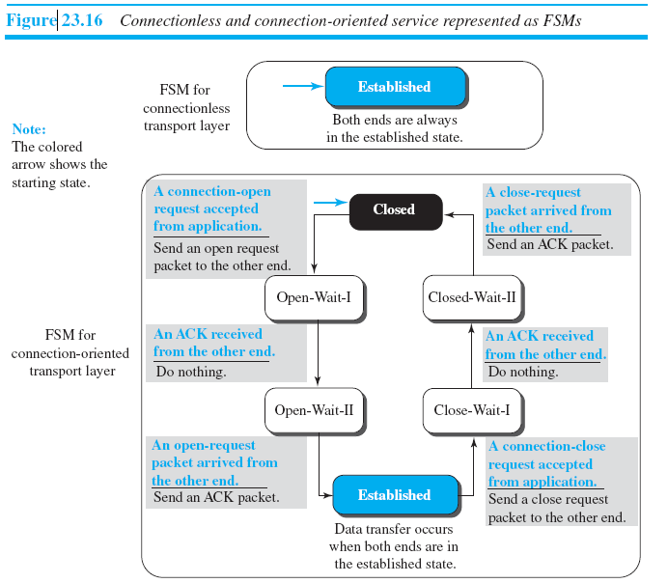

Slide 21
USER DATAGRAM PROTOCOL
UDP is an unreliable connectionless transport-layer protocol used for its simplicity and efficiency in applications where error control can be provided by the application-layer process.

Slide 22
Why use UDP?
UDP is a very simple protocol using a minimum of overhead.
If a process wants to send a small message and does not care much about reliability, it can use UDP.

Slide 23
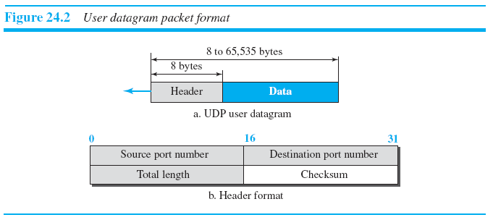

Slide 24
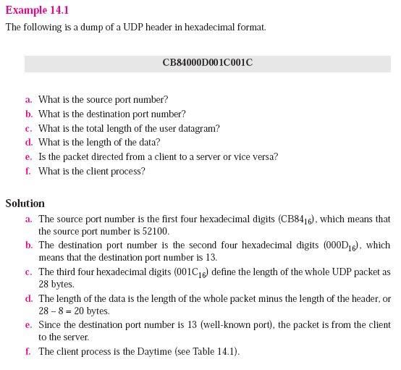

Slide 25
UDP Services
Process-to-Process Communication
UDP provides process-to-process communication using socket addresses, a combination of IP addresses and port numbers.

Slide 26
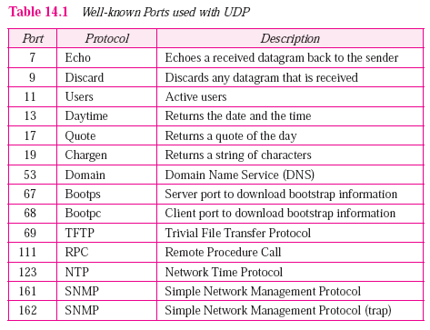

Slide 27
UDP Services
Checksum
What is Pseudo header?
In Simple words, Pseudo header is one type of demo header that basically helps in calculating the CheckSum of TCP/UDP Packets. From the TCP or UDP point of view, the TCP packet does not contain IP addresses. Thus, to do a proper checksum, a "pseudo-header" is included.

Slide 28
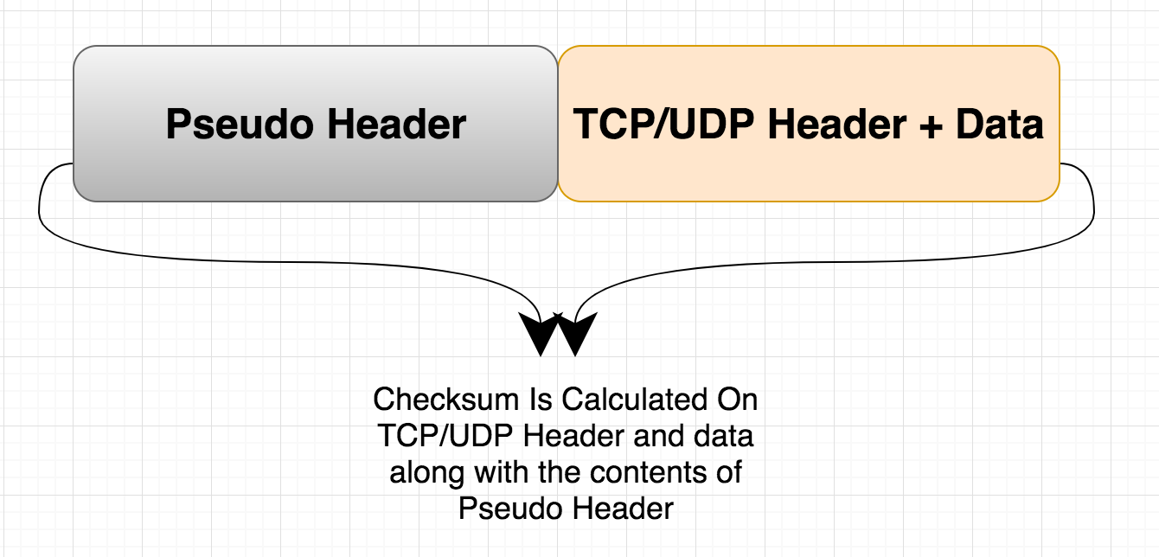

Slide 29
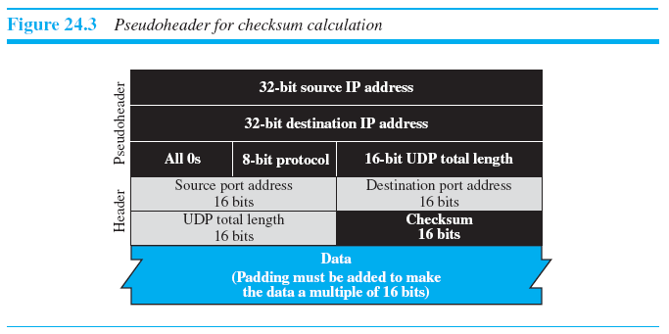

Slide 30
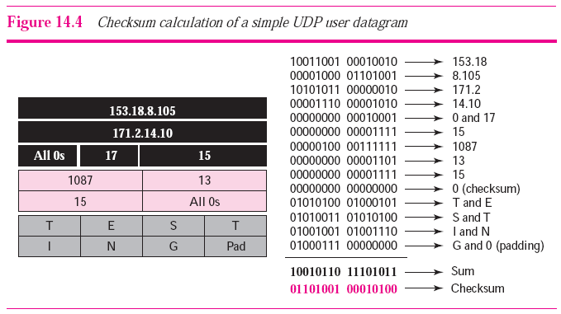

Slide 31
UDP Services
Connectionless Services
UDP provides a connectionless service.
Each user datagram sent by UDP is an independent datagram.
There is no relationship between the different user datagrams even if they are coming from the same source process and going to the same destination program.

Slide 32
UDP Services
Flow Control
UDP is a very simple protocol. There is no flow control, and hence no window mechanism.
Error Control
There is no error control mechanism in UDP except for the checksum.
Sender does not know if a message has been lost or duplicated.
When the receiver detects an error through the checksum, the user datagram is silently discarded.
The lack of error control means that the process using UDP should provide for this service, if needed.

Slide 33
UDP Services
Congestion Control
UDP is a connectionless protocol, it does not provide congestion control.
Encapsulation and Decapsulation

Slide 34
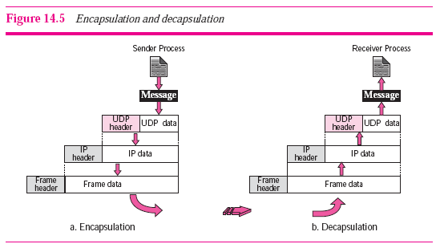

Slide 35
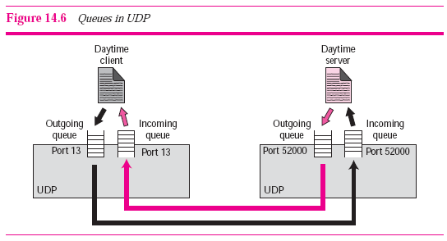

Slide 36
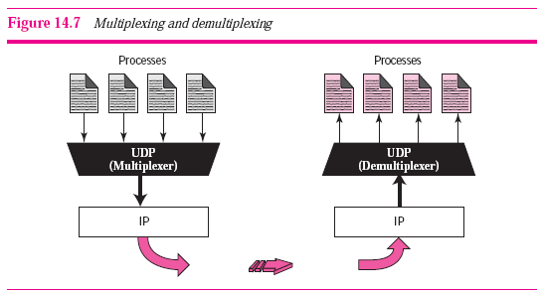
UDP Services
Multiplexing and Demultiplexing

Slide 37
UDP Applications
Trivial File Transfer Protocol (TFTP) process includes flow and error control. It can easily use UDP.
UDP is a suitable transport protocol for multicasting.
UDP is used for management processes such as SNMP
UDP is used for some route updating protocols such as Routing Information Protocol (RIP)
UDP is normally used for interactive real-time applications that cannot tolerate uneven delay between sections of a received message.

Slide 38
TRANSMISSION CONTROL PROTOCOL
Transmission Control Protocol (TCP) is a connection-oriented, reliable protocol.
TCP explicitly defines connection establishment, data transfer, and connection termination phases to provide a connection-oriented service.
TCP uses a combination of GBN and SR protocols to provide reliability.
TCP uses checksum (for error detection), retransmission of lost or corrupted packets, cumulative and selective acknowledgments, and timers.

Slide 39
TCP Services
Process-to-Process Communication
TCP provides process-to-process communication using port numbers.
Stream Delivery Service
The sending process produces (writes to) the stream and the receiving process consumes (reads from) it.

Slide 40
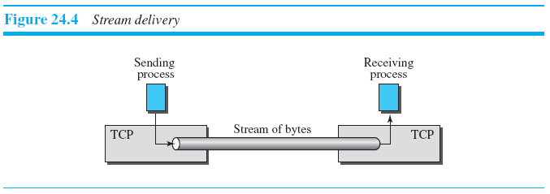
TCP Services
Imaginary tube to carry date from S to R

Slide 41
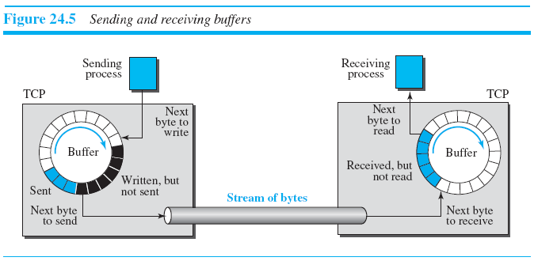
TCP Services
Sending and Receiving Buffers

Slide 42
TCP Services
Segments
Buffering - disparity between the speed of the producing and consuming processes.
The network layer, as a service provider for TCP, needs to send data in packets, not as a stream of bytes.
TCP groups a number of bytes together into a packet called a segment.
Header added to every segment

Slide 43
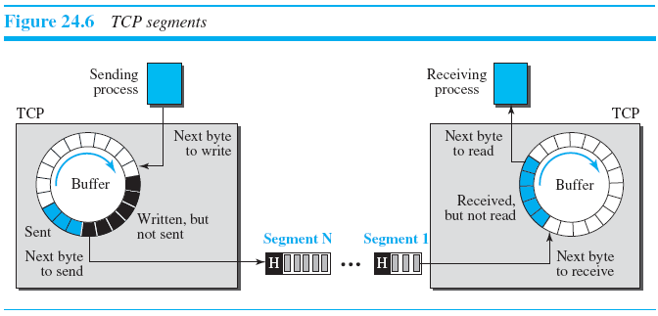

Slide 44
TCP Services
Full-Duplex Communication
TCP offers full-duplex services
Multiplexing and Demultiplexing
Like UDP, TCP performs multiplexing at the sender and demultiplexing at the receiver.

Slide 45
TCP Services
Connection-Oriented Service
TCP is connection oriented
1. The two TCP’s establish a logical connection between them.
2. Data are exchanged in both directions.
3. The connection is terminated.
logical connection, not a physical connection.

Slide 46
TCP Services
Reliable Service
TCP is a reliable transport protocol.
It uses an acknowledgment mechanism to check the safe and sound arrival of data.

Slide 47
TCP Features
Numbering System
sequence number and the acknowledgment number.
These two fields refer to a byte number and not a segment number.
Byte Number
TCP numbers all data bytes (octets) that are transmitted in a connection.
Numbering is arbitrary

Slide 48
TCP Features
Sequence Number
1. The sequence number of the first segment is the ISN (initial sequence number),
which is a random number.
2. The sequence number of any other segment is the sequence number of the previous segment plus the number of bytes (real or imaginary) carried by the previous segment.

Slide 49
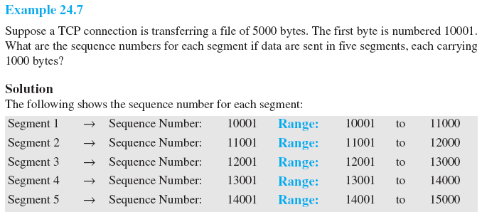

Slide 50
TCP Features
Acknowledgment Number
The value of the acknowledgment field in a segment defines the number of the next byte a party expects to receive. The acknowledgment number is cumulative.

Slide 51
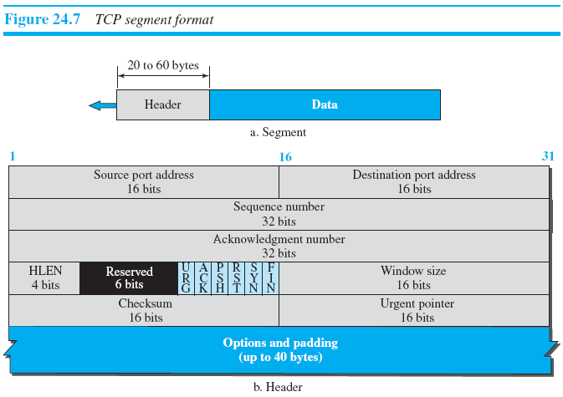
TCP Features
Segment

Slide 52
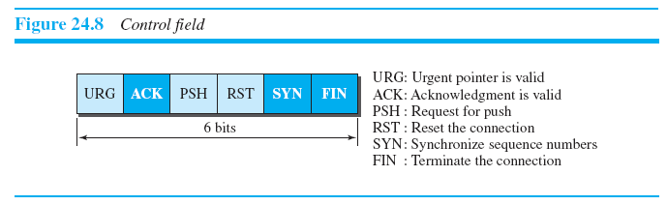

Slide 53
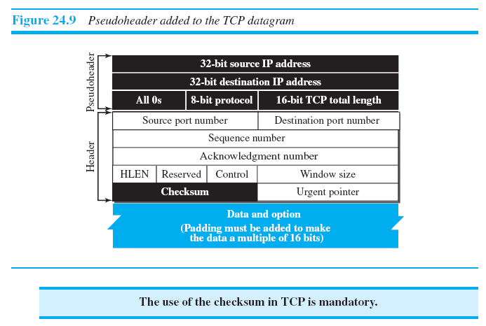

Slide 54
TCP Features
Encapsulation
A TCP segment encapsulates the data received from the application layer. The TCP segment is encapsulated in an IP datagram, which in turn is encapsulated in a frame at the data-link layer.

Slide 55
A TCP Connection
Connection Establishment
Data Transfer
Connection Termination

Slide 56
Connection Establishment
TCP transmits data in full duplex mode.
Three-Way Handshake
  Server program tells its TCP that it is ready to accept a connection. This request is called a passive open.
  The client program issues a request for an active open.

Slide 57
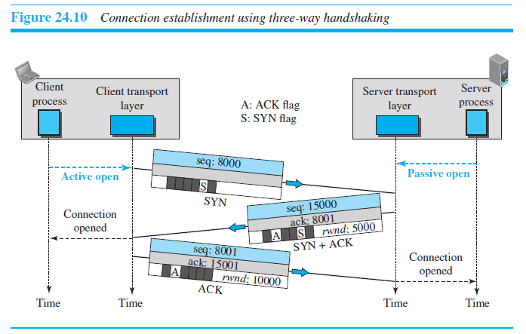
Connection Establishment

Slide 58
Connection Establishment
The client sends the first segment, a SYN segment
  Only the SYN flag is set.
  This segment is for synchronization of sequence numbers
  segment does not contain an acknowledgment number
  Does not define window size.
  SYN segment cannot carry data, but it consumes one sequence number ( for one imaginary byte).

Slide 59
Connection Establishment
Server sends the second segment, a SYN + ACK.
This segment has a dual purpose:
  SYN segment for communication in the other direction(initialize a sequence number for numbering the bytes sent from the server to the client).
  The server also acknowledges the receipt of the SYN segment from the client by setting ACK flag.
Because segment contains an ACK, it also need to define window size, rwnd(to be used by client).
A SYN + ACK segment cannot carry data, but it does consume one sequence number.

Slide 60
Connection Establishment
The client sends the third segment – an ACK segment.
An ACK segment, if carrying no data, consumes no sequence number.

Slide 61
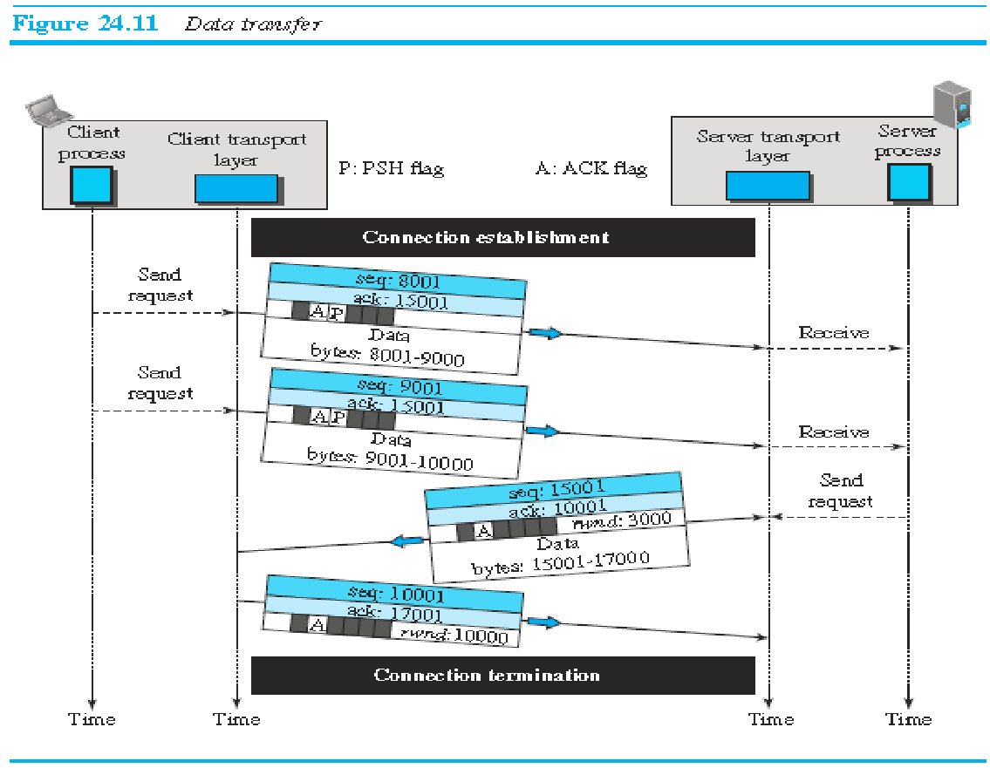
Data Transfer

Slide 62
Data Transfer
After connection establishment, bidirectional data transfer can take place.
acknowledgment can be piggybacked with the data.
Pushing Data:
  Delayed transmission and delayed delivery of data may not be acceptable by the application program.
  application program at the sender can request a push operation
  TCP can choose whether or not to use this feature.

Slide 63
Data Transfer
After connection establishment, bidirectional data transfer can take place
Urgent Data :
  Each byte of data has a position in the stream. However, there are occasions in which an application program needs to send urgent bytes
  send a segment with the URG bit set.
  Sending TCP send a segment with the URG bit set.
  Sending TCP creates a segment and inserts the urgent data at the beginning of the segment, rest segment can carry normal data.
  The urgent pointer field in the header defines the end of the urgent data (the last byte of urgent data).

Slide 64
Urgent Flag/Pointer
For example, if
the segment sequence number is 15000 and the value of the urgent pointer is 200, the first byte of urgent data is the byte 15000 and the last byte is the byte 15200. The rest of the bytes in the segment (if present) are non-urgent.

Slide 65
Connection Termination
Either of client or server can close the connection, usually initiated by the client.
Most implementation allow two options:
  Three way handshaking
  Four way handshaking with Half-close option.

Slide 66
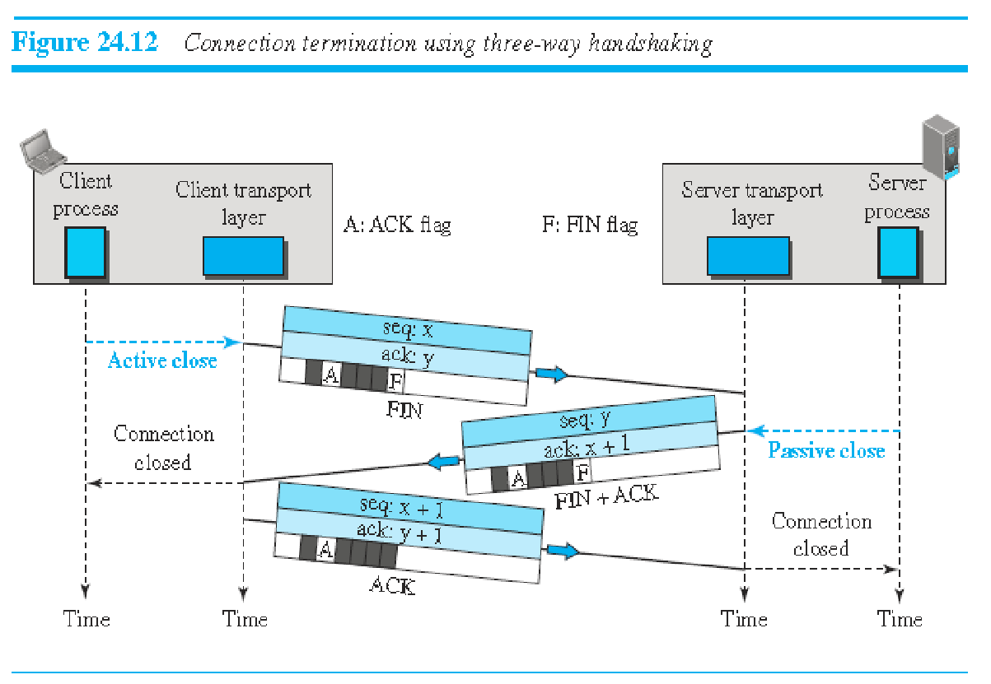
Connection Termination

Slide 67
Connection Termination
I. Three Way Handshake :
Client TCP sends a FIN segment in which FIN flag is set.
FIN segment can include the last chunk of data sent by the client or it can be just a control segment.
The FIN segment consumes one sequence number if it does not carry data.

Slide 68
Connection Termination
II. Three Way Handshake :
Server TCP, after receiving FIN segment sends a FIN+ACK segment to confirm receipt of FIN segment and also to announce closing of connection in other direction.
This segment can also carry last chunk of data from server.
If it does not carry data, it consumes only one sequence number because it needs to be acknowledged.

Slide 69
Connection Termination
III. Three Way Handshake :
Client TCP sends the last segment, an ACK segment, to confirm the receipt of the FIN segment from the TCP server.
This segment cannot carry data and consumes no sequence numbers

Slide 70
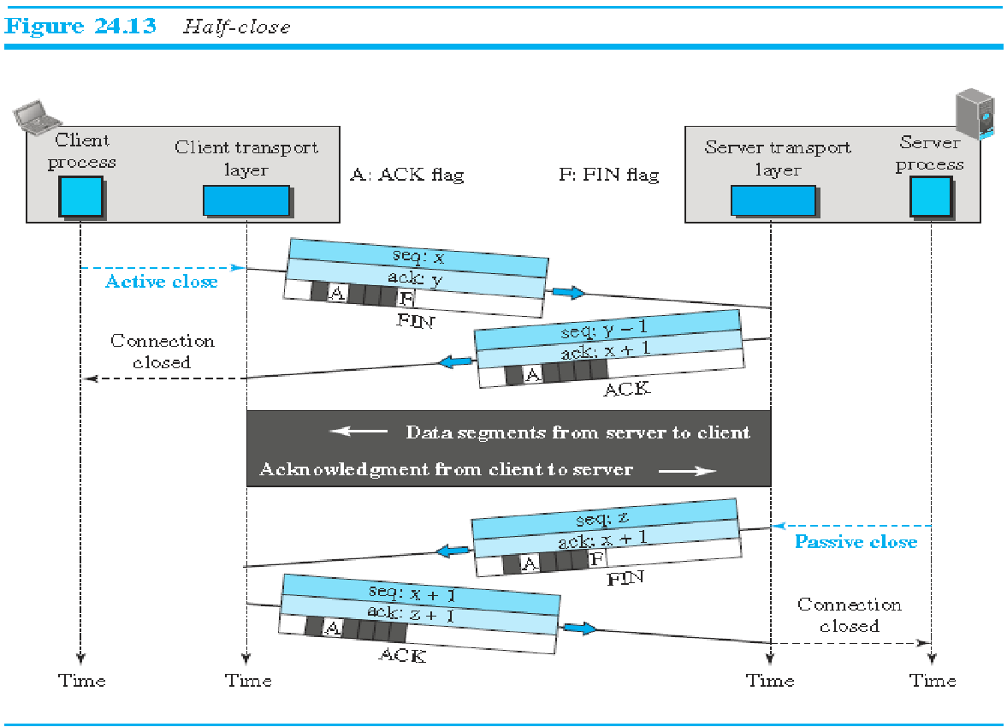
Half Close

Slide 71
Half Close
one end can stop sending data while still receiving data.

Slide 72
Connection Reset
TCP at one end,
  may deny a connection request
  may abort an existing connection
  may terminate an idle connection
All above is done using RST flag.

Slide 73
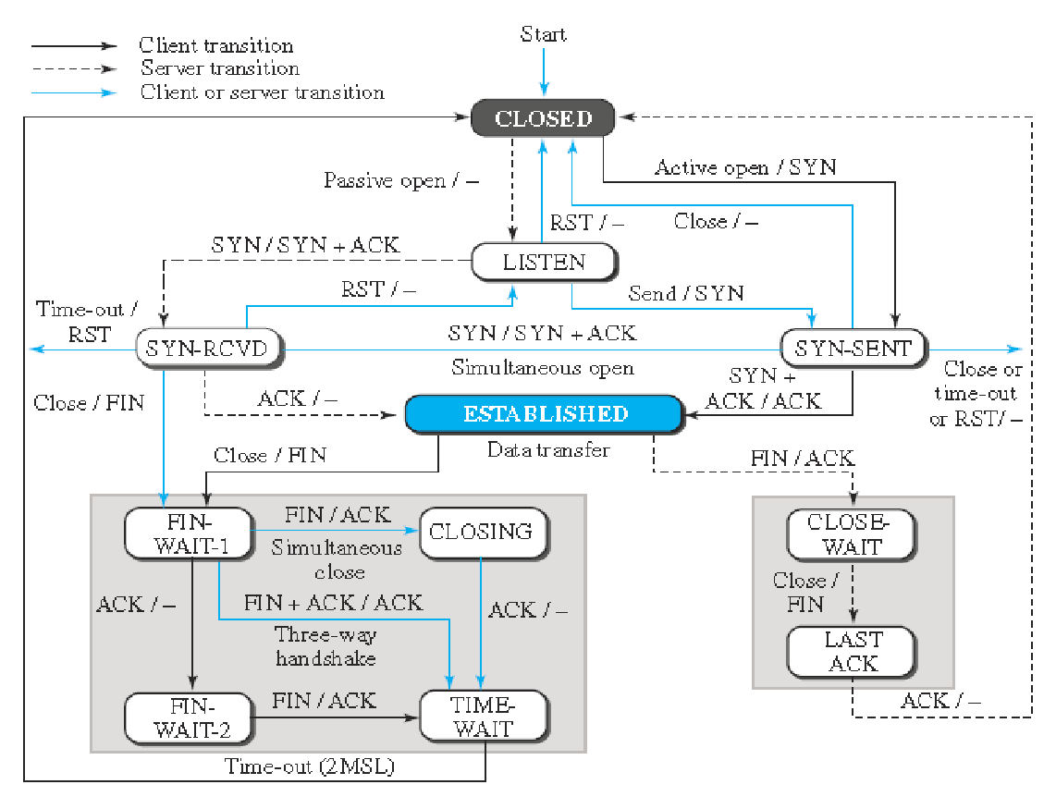
State Transition Diagram

Slide 74
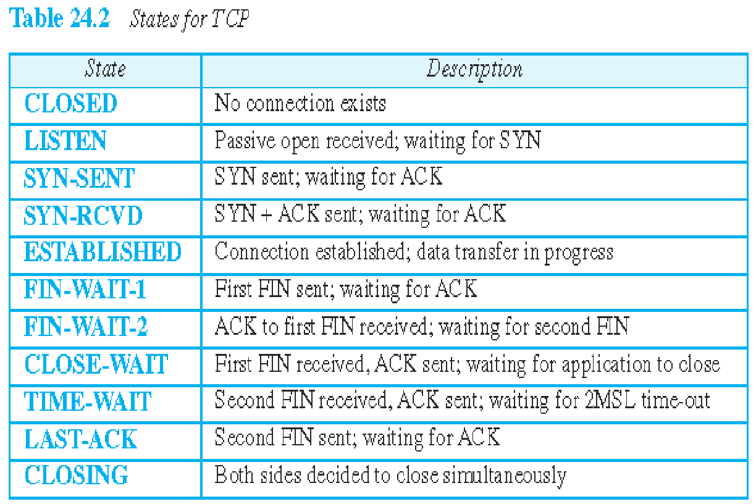

Slide 75
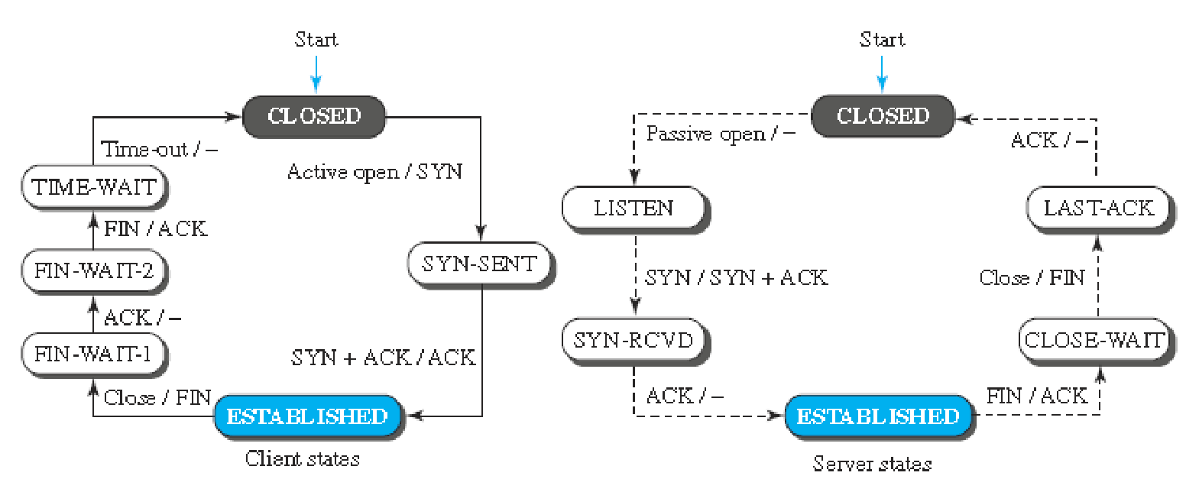
Half Close Scenario

Slide 76
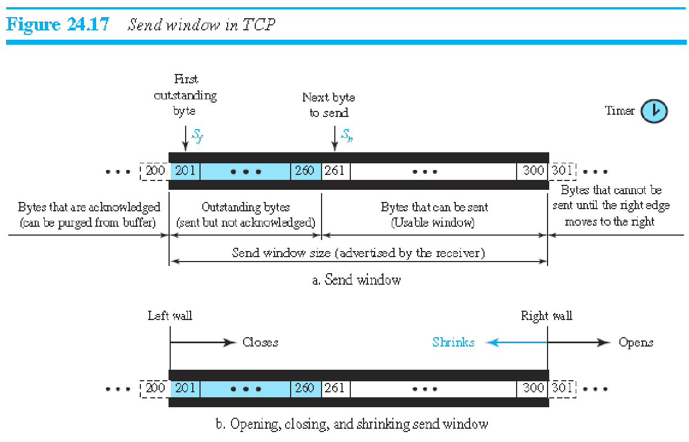
Windows in TCP

Slide 77
Send Window
Send window size is dictated by the receiver (flow control) and the congestion in the underlying network (congestion control).
The figure shows how a send window opens, closes, or shrinks.

Slide 78
Difference between TCP and SR send window
window size in SR is the number of packets, but the window size in TCP is the number of bytes.
TCP can store data received from the process and send them later, but sending TCP is capable of sending segments of data as soon as it receives them from its process.
number of timers

Slide 79
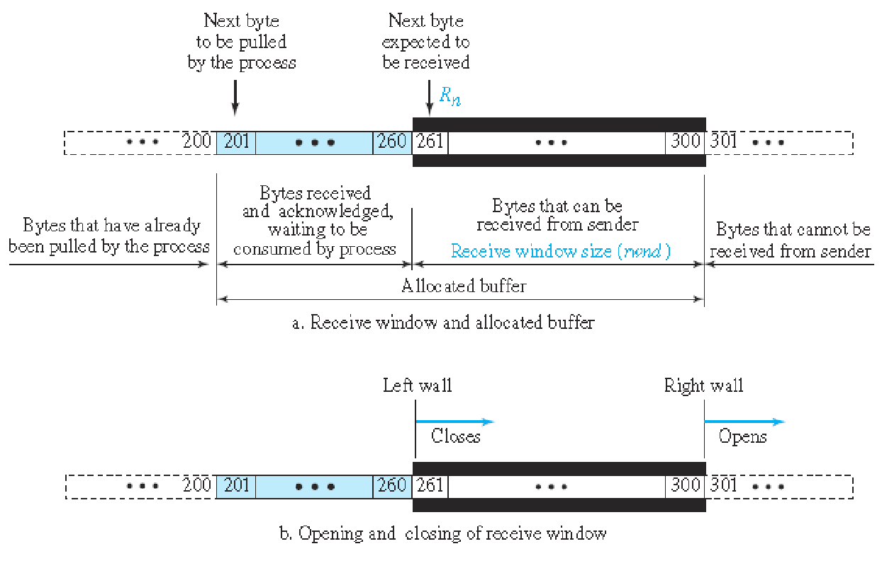
Receive Window

Slide 80
Difference between TCP and SR Receive window
TCP allows the receiving process to pull data at its own pace.
The receive window size determines the number of bytes that the receive window can accept from the sender before being overwhelmed (flow control)
rwnd = buffer size - number of waiting bytes to be pulled
Acknowledgments : New version of uses both cumulative and selective acknowledgments

Slide 81
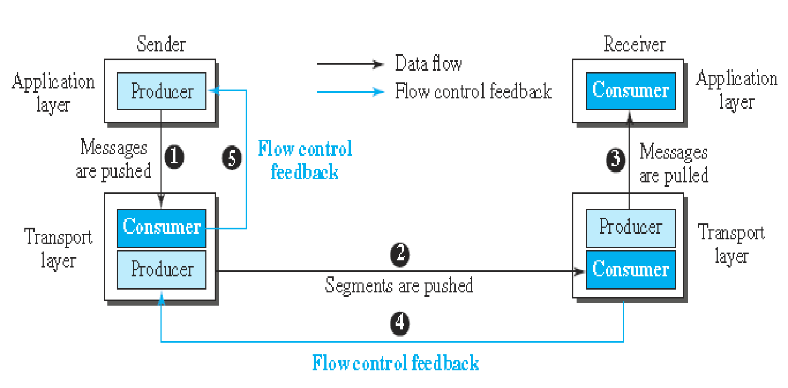
Flow Control

Slide 82
Flow Control
To achieve flow control, TCP forces the sender and the receiver to adjust their window sizes,
The size of the buffer for both parties is fixed when the connection is established.
The opening, closing, and shrinking of the send window is controlled by the receiver.
The send window closes (moves its left wall to the right) when a new acknowledgment allows it to do so.
The send window opens (its right wall moves to the right) when the receive window size (rwnd) advertised by the receiver allows it to do so.

Slide 83
The receive window closes (moves its left wall to the right) when more bytes arrive from the sender;
It opens (moves its right wall to the right) when more bytes are pulled by the process.

Slide 84
Shrinking of Windows
Receive window cannot shrink.
Send window, can shrink if the receiver defines a value for rwnd that results in shrinking the window
Some implementation doesn’t allow shrinking of sender window
the receiver needs to keep the following relationship between the last and new acknowledgment and the last and new rwnd values to prevent shrinking of the send window.
new ackNo + new rwnd ≥ last ackNo + last rwnd
(210) + (4) < (206) + (12)

Slide 85
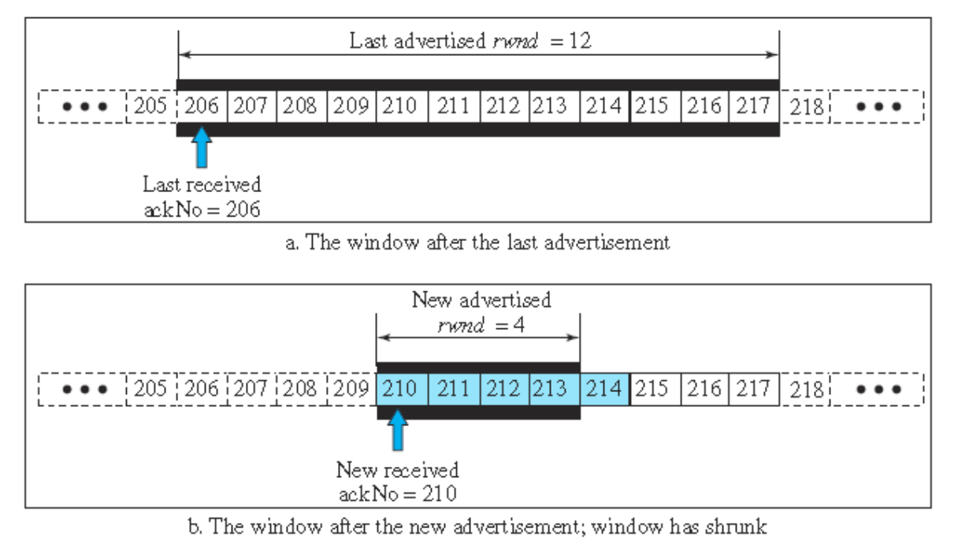
Shrinking of WIndows

